Slide 1
Mining High Utility Itemsets without Candidate Generation
Date: 2013/05/13
Author: Mengchi Liu, Junfeng Qu
Source: CIKM "12
Advisor: Jia-ling Koh
Speaker: I-Chih Chiu

Slide 2
Outline
Introduction
Problem Definition
Utility-List Structure
High Utility Itemset Miner
Experiment
Conclusion

Slide 3
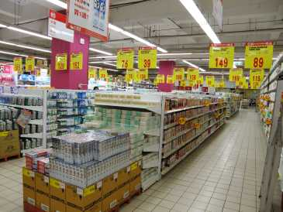
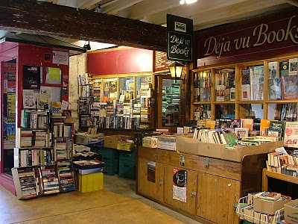
Introduction
The rapid development of database techniques facilitates the storage and usage of massive data from business corporations, governments, and scientific organizations.
The high utility itemset mining problem is one of the most important from the famous frequent itemset mining problem.

Slide 4
Introduction
Traditional frequent itemset mining algorithms cannot evaluate the utility information about itemsets.
In a supermarket database
Each item has a distinct price/profit.
Each item in a transaction is associated with a distinct quantity.
An itemset with high support may have low utility
Ex :
transaction | support | total utility
egg, bread | 10 | 30
beef, pork | 5 | 45

Slide 5
Motivation
Recently, a number of high utility itemset mining algorithms have been proposed.
Generate candidate high utility itemsets.
Compute the exact utilities of the candidates by scanning the database to identify high utility itemsets.
However, the algorithms often generate a very large number of candidate itemsets.
Excessive memory requirement for storing candidate itemsets.
A large amount of running time for generating candidates and computing their exact utilities.

Slide 6
Goal
A novel structure, called utility-list, is proposed.
the utility information about an itemset
the heuristic information about whether the itemset should be pruned or not.
An efficient algorithm, called HUI-Miner (High Utility Itemset Miner), is developed.
It does not generate candidate high utility itemsets.
It can mine high utility itemsets after constructing the initial utility-lists.

Slide 7
Diagram
transactions
High utility itemsets
Construct
utility list
HUI-Miner

Slide 8
Outline
Introduction
Problem Definition
Utility-List Structure
High Utility Itemset Miner
Experiment
Conclusion

Slide 9
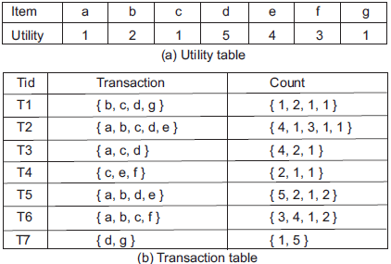
Problem Definition
$I=\{i_{1},i_{2},i_{3},…,i_{n}\}$ : a set of items.
Each transaction($T$) has a unique identifier($tid$).
Def. 1. $iu(i, T)$ : $internal utility$ is the $count value(quantity)$ associated with $i$ in T in the $transaction table$.
Def. 2. $eu(i)$ : $external utility$ is the $utility value(profit)$of $i$ in the $utility table$.
Def. 3. $u(i, T)$ : $utility$ is the product of $iu(i, T)$and $eu\left(i\right)$.
Ex :
$$iu\left(e,T5 \right)=2$$
$$eu\left(e\right)=4$$
$$u\left(e,T5\right)=iu\left(e, T5\right)×eu\left(e\right) \\ =2×4=8$$

Slide 10
Def. 4. $u(X,T)$ : The $utility$ of $itemset X$ in $transaction T$ is the sum of the utilities of all the items in $X$ in $T$, where $u\left(X,T\right)=\sum_{i∈X∧X⊆T}{u(i,T)}$.
Def. 5. $u(X)$ : The $utility$ of $itemset X$ is the sum of the utilities of $X$ in all the transactions in $DB$, where $u\left(X\right)=\sum_{T∈DB∧X⊆T}{u(X,T)}$.
Def. 6. $tu(T)$ : The $utility$ of $transaction T$ is the sum of the utilities of all the items in $T$, where $tu\left(T\right)=\sum_{i∈T}{u(i,T)}$.
Ex :
$$u\left(\{ae\},T2\right)=u\left(a,T2\right)+u\left(e,T2\right) \\ =4×1+1×4=8$$
$$u\left(\{ae\}\right)=u\left(\{ae\}, T2\right)+u\left(\left\{ae\right\},T5\right) \\ =8+13 =21$$
Ex :
$$tu\left(T1\right)=u\left(b,T1\right)+u\left(c,T1\right)+u\left(d,T1\right)+u\left(g,T1\right)$$ $=1×2+2×1+1×5+1×1=10$
$$Transaction Utility$$

Slide 11
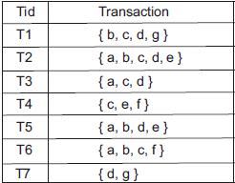
Def. 7. $twu(X)$ : The $transaction−weighted utility$of itemset $X$ in $DB$ is the sum of the utilities of all the transactions containing X in DB, where $twu\left(X\right)=\sum_{T∈DB∧X⊆T}{tu(T)}$.
Property 1. If $twu(X)$ is less than a given “minutil”, all supersets of $X$ are not high utility.
Rationale. $If X⊆X^{′},then u(X^{′})≤twu(X^{′})≤twu(X)<minutil$
Ex :
$$twu\left(\{f\}\right)=tu\left(T4\right)+tu\left(T6\right) \\ =9+18=27$$
$$Transaction Utility$$
$$Transaction−Weighted Utility$$
Ex :
Assume minutil=30, $twu\left(\left\{f\right\}\right)=27<30$
According to Property 1,
all supersets of $\{f\}$ are not high utility.

Slide 12
Outline
Introduction
Problem Definition
Utility-List Structure
Initial Utility-Lists
Utility-Lists of 2-Itemsets
Utility-Lists of k-Itemsets(k$≥$3)
High Utility Itemset Miner
Experiment
Conclusion

Slide 13
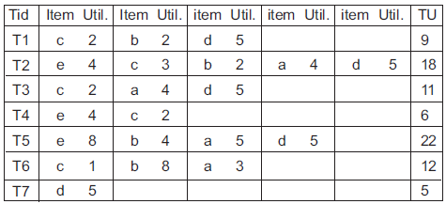
Initial Utility-Lists
Def. 8. A transaction is considered as “revised“ after
(1) all the items whose transaction-weighted utilities are less than a given $minutil$are deleted from the transaction.
(2) the remaining items are sorted in transaction-weighted- utility-ascending order.
The remaining items are sorted: e<c<b<a<d
Suppose $minutil=30$
$$Transaction−Weighted Utility$$
$$All Revised Transactions$$
Notes:
為何要要用twu由小而大排列

Slide 14
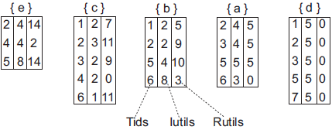
Def. 9 $T/X$ : The set of all the items after $X$ in $T$ .
$X$ : an itemset, $T$ : a transaction (or itemset)
Def. 10. $ru(X,T)$ : The $remaining utility$of itemset X in transaction T is the sum of the utilities of all the items in $T/X$ in $T$, where $ru\left(X,T\right)=\sum_{i∈(T/X)}{u(i,T)}$.
Ex :
$${T2}/{\left\{eb\right\}=\{ad\}}$$
$${T2}/{\left\{c\right\}=\{bad\}}$$
$$All Revised Transactions$$
Tids : a transaction T containing X
Iutils : the utility of X in T, i.e., $u(X, T)$
Rutils : the remaining utility of X in T, i.e., $ru(X,T)$
Ex :
$$X=\left\{c\right\} in T3$$
$$Iutil=u(X,T2)=2$$
$$Rutil=ru\left(X,T2\right)=$$ $u(a,T2)+u(d,T2)=9$
<3,2,9> is in the utility-list of {c}.
$$Initial Utility−Lists$$

Slide 15
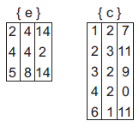
Utility-Lists of 2-Itemsets
No need for database scan.
identifying common
transactions
Utility-lists
of 2-itemset
$$Iutil=u\left(\left\{ec\right\},T2\right)$$
$$=4+3=7$$
$$Rutil=ru\left(\left\{ec\right\},T2\right)$$
$$=2+4+5=11$$
$$Iutil=u\left(\left\{ec\right\},T4\right)$$
$$=4+2=6$$
$$Rutil=ru\left(\left\{ec\right\},T4\right)$$
$$=0$$

Slide 16
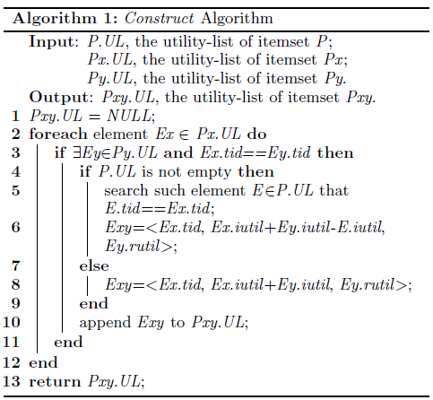
Utility-Lists of k-Itemsets
To construct the utility-list of k-itemset $\{i_{1}…i_{(k−1)}i_{k}\}$ ($k≥3$)
Intersect the utility-list of $\{i_{1}…i_{(k−2)}i_{k−1}\}$ and $\{i_{1}…i_{(k−2)}i_{k}\}$
Ex :
{$eba$}
(k$≥$3)
(k=2)

Slide 17
Outline
Introduction
Problem Definition
Utility-List Structure
High Utility Itemset Miner
Search space
Pruning Strategy
HUI-Miner Algorithm
Experiment
Conclusion

Slide 18
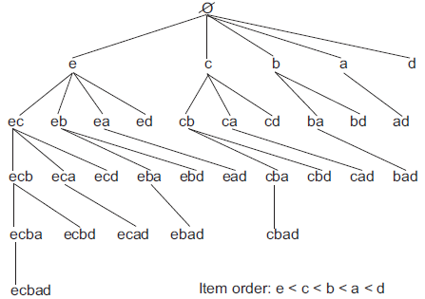
Search space
Set-Enumeration Tree
Def. 11. Given a set-enumeration tree, an itemset represented by a node is called an extension of an itemset represented by an ancestor node of the node. For an itemset containing $k$ items, its extension containing $(k+i)$items is called an $i$-$extension$ of the itemset.
Ex :
$\{eba\},\{ebd\}$: the 1-extension of $\{eb\}$
$\{ebad\}$: the 2-extension of $\{eb\}$
Def. 9
Property 2. If $X′$ is an extension of $X$, $(X′−X)=(X′/X)$
Rationale. Any extension of X is a combination of X with the item(s) after X.

Slide 19
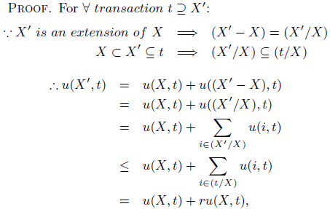
Pruning Strategy
Exhaustive search → Time consuming
Lemma 1. Given the utility-list of $itemset X$, if the sum of all the $iutils$and $rutils$in the utility-list is less than a given “$minutil$”, any extension $X′$ of $X$ is not high utility.
$$Assume X=\left\{ec\right\}, X’=\{ecb\}$$
$$t=T2=\{ecbad\},$$
$$(X’/X)=\{b\}, (t/X)=\{bad\}$$
$$u\left(\left\{ecb\right\},T2\right)$$
$$=u(\{ec\},T2)+u(\{b\},T2)$$
$$≤u(\{ec\},T2)+u(\{bad\},T2)$$
$$=u(\{ec\},T2)+ru(\{ec\},T2)$$
Notes:
窮舉搜尋固然可以找到所有high utility itemsets，但是卻相當耗時的 因為在database內的item個數非常龐大，若item個數有n個，則窮舉會產生出二的n次方itemsets

Slide 20
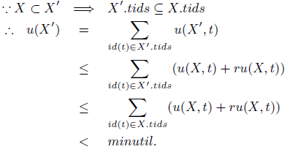
$id(t)$: the $tid$ of transaction $t$
$X.tids$ : the $tid$set in the utility-list of $X$
$X′.tids$ : the $tid$set in the utility-list of $X$’
$$\left\{ec\right\}⊂\left\{ecb\right\}⇒\left\{T2\right\}⊆\{T2,t4\}$$
$$u\left(\{ecb\}\right)$$
$$=u\left(\left\{ecb\right\},T2\right)$$
$$≤u\left(\left\{ec\right\},T2\right)+ru(\left\{ec\right\},T2)$$
$$≤u\left(\left\{ec\right\},T2\right)+ru\left(\left\{ec\right\},T2\right)$$
$+u\left(\left\{ec\right\},T4\right)+ru(\left\{ec\right\},T4)$
$$<minutil$$
Ex :
Suppose $minutil=30$
The sum of all the
iutils amd rutils
$⇒$7+6+11=24 < 30

Slide 21
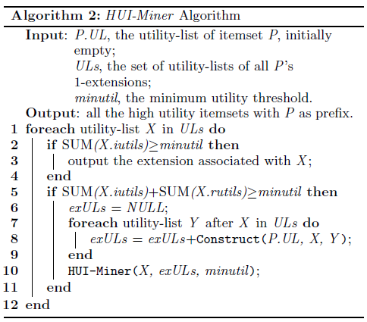
HUI-Miner Algorithm

Slide 22
Outline
Introduction
Problem Definition
Utility-List Structure
High Utility Itemset Miner
Experiment
Conclusion

Slide 23
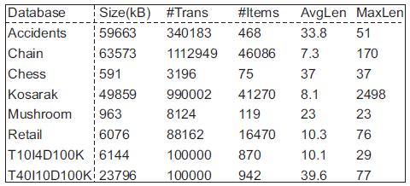
Experimental Setup
Besides HUI-Miner, experiments include three algorithms
IHUPTWU
UP-Growth
UP-Growth+
Eight databases
real
synthetic

Slide 24
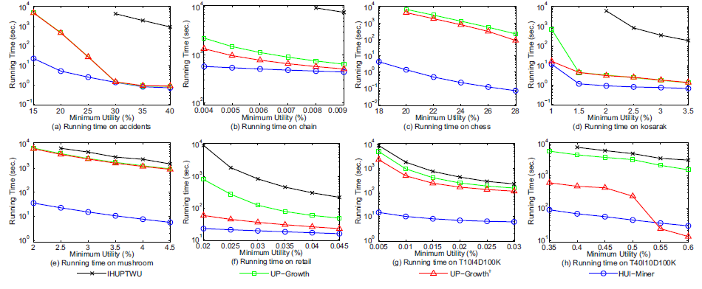
Running Time
Terminated a mining task, once its running time exceeds 10000 seconds.
For most sparse databases, the performance superiority of HUI-Miner becomes very significant when the $minutil$decreases.
Notes:
Input time , CPU time , output time

Slide 25
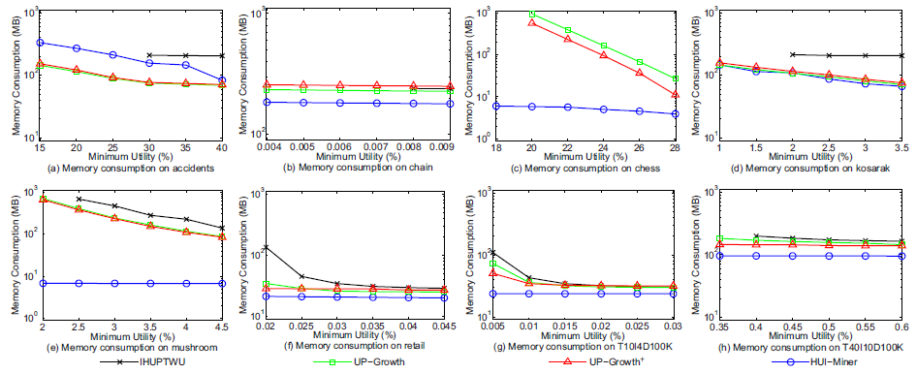
Memory Consumption
Except for database accidents in (a), HUI-Miner always consumes less memory than the other algorithms.
Another observation is that UP-Growth+ consumes more memory than UP-Growth in (b) and(d).
UP-Growth+ holds more information than UPGrowth in sparse and large database.

Slide 26
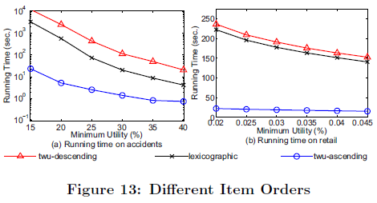
Experiment
Processing Order of Items
The processing order of items significantly influences the performance of a high utility itemset mining algorithm.

Slide 27
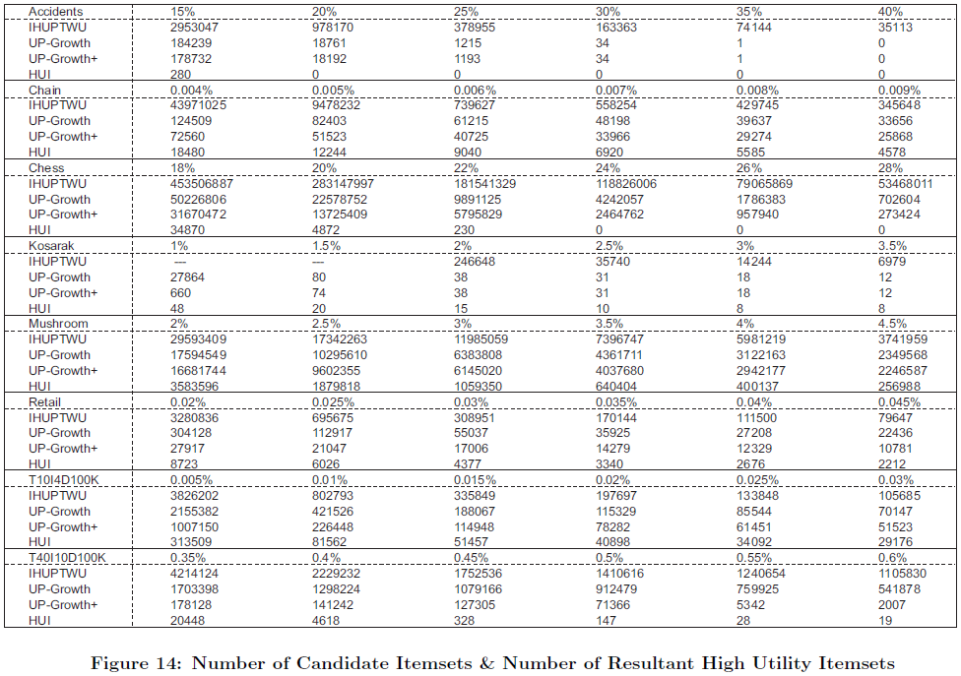

Slide 28
Outline
Introduction
Problem Definition
Utility-List Structure
High Utility Itemset Miner
Experiment
Conclusion

Slide 29
Conclusion
Proposed a novel data structure, utility-list, and developed an efficient algorithm, HUI-Miner, for high utility itemset mining.
Utility-lists provide not only utility information about itemsets but also important pruning information for HUI-Miner.
HUI-Miner can mine high utility itemsets without candidate generation, which avoids the costly generation and utility computation of candidates.

